Slide 1
Unit 1
Part 2

Slide 2
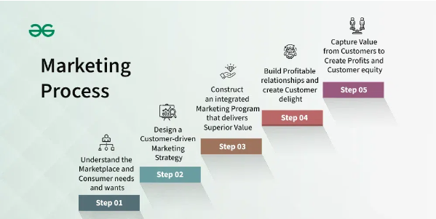
Marketing Process
The marketing process is a systematic approach used by businesses to promote their products or services to potential customers. It involves several steps that are designed to understand customer needs, create value, and ultimately drive sales. Here are the typical stages of the marketing process. The marketing process aims to make potential customers aware of the company’s presence and develop the brand’s identity to sell to those customers. While marketing processes can differ widely depending on the company and the industry, they usually have five steps.

Slide 3
Understanding the marketplace, consumer needs and want:
This stage involves comprehensive market research to gain insights into the industry, target audience, competitors, and trends. Understanding the market enables businesses to identify opportunities and challenges.
Knowing the local market/area/country/region.
Identifying the preferences of the target audience.
Determining how much consumers are willing to spend on what you sell; particularly, their purchasing power.
Example: Let's say a company is launching a new line of skincare products. To understand customer needs, they conduct market research, including surveys, focus groups, and analyzing social media trends. Through this research, they discover that there is a growing demand for organic and cruelty-free skincare products among environmentally-conscious consumers.

Slide 4
Design a customer-driven market strategy:
Once the market is understood, businesses delve deeper into understanding their target audience. This involves segmenting the market based on demographics, psychographics, behavior, or other relevant factors. By identifying specific segments, businesses can tailor their marketing strategies to meet the unique needs and preferences of each group.
Identify which clients to serve; i.e., establish the target market. And understanding the target audience can help the business better understand its requirements and desires as well as how to best satisfy them.
Determining the best approach to service clients. Also getting to know the target market better than the competitor. This is the point at which marketers can distinguish their brand in the market.
Example: Based on the research findings, the company decides to segment the market. They identify three main segments: eco-conscious millennials, luxury enthusiasts, and budget-conscious shoppers. Each segment has different needs, preferences, and buying behaviors.

Slide 5
Construct an integrated marketing program that delivers superior value:
This can be implemented using the marketing mix, that covers your budget, USP, the types of digital marketing channels you will need to promote your brand, utilization of modern technology, etc. These will be necessary to achieve your main objectives. And it will provide customers the value. Setting up KPIs and regularly monitoring them will help at this stage. Implementing an integrated marketing program that delivers superior value, organizations can effectively attract, engage, and retain customers, drive business growth, and achieve sustainable competitive advantage in the marketplace.

Slide 6
Build profitable relationship and create customer delight:
The bottom line for an organization is that profit and customer relationships are the “secret sauce” of any business. This step in the marketing process is where marketers acquire, keep, and grow customer relationships. Successful marketers know that acquiring customers is one of the hardest (not to mention one of the most expensive) elements of marketing. However, when you know clearly who those potential customers are, you can more effectively determine how to reach them, thus maximizing your marketing profits. Marketers need to remind customers about the company’s products and/or services and how those products and services have met their needs and improved their lives, so they make repeat purchases. Marketers need to consider how to reach customers about their offerings and make it easy and convenient for those customers to make continued purchases.

Slide 7
Capture value from customer to create profit and customer equity:
The goal of successful customer relationship management is creating high customer equity the potential profits a company earns from its current and potential customers. It’s a relatively simple concept: increasing customer loyalty results in higher customer equity. Increasing customer equity is the goal of marketers because it’s a bellwether for financial success. Think about it in simple terms: the higher a company’s customer equity the more profit the company generates, and the more valuable that company (and its products or services) becomes on the market.

Slide 8
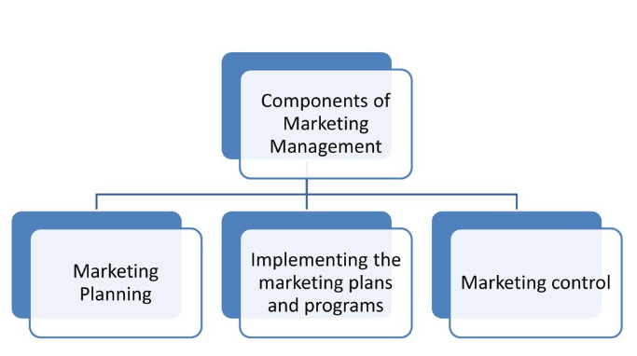
Task of Marketing Management
Marketing management encompasses the planning, implementation, and control of activities designed to create, communicate, deliver, and exchange offerings that have value for customers, clients, partners, and society at large. In simpler terms, it's about guiding the process of promoting and selling products or services to customers.
The process of planning and executing the conception, pricing , promotion and services to create exchanges that satisfy individuals and organizational goals,”American Marketing Association”

Slide 9
Marketing Planning:
It is the process of making a coordinated set of decision that constitute a marketing strategy for one or more target market. Marketing planning involves the process of creating a roadmap or blueprint for achieving marketing objectives within a specified time frame. It outlines the strategies, tactics, and actions needed to reach target customers, promote products or services, and generate sales or other desired outcomes. Marketing planning typically involves several key steps:
Situation analysis: Assessing or scanning the environmental forces prevailed in the market, which have greater effect on company’s performance and achievement of desired goal.
Swot analysis: It gives summary of the strength and weakness of the company together with the opportunities and threats it faces.
Establishing marketing goal or target to be achieve over time

Slide 10
Designing the marketing program which include product design, price mechanism, distribution system, promotional bled and service delivery process etc.
Allocation of resources for each marketing program.
Determining supervising style and setting performance standard.

Slide 11
Implementing the Marketing Plans and Programs:
It involves translating the strategic objectives outlined in the marketing plan into actionable tactics and initiatives. It means executing or putting the plans and programs into action in a coordinated manner. Following are the action step-by-step guide on how to effectively implement marketing plans and programs:
Develop a properly matched organization structure.
Recruitment and selection of appropriate manpower and assign them the right jobs.
Create efficient work teams and assure effective participation of the team members to execute the assigned job effectively.
Develop an effective communication system.
Develop an effective leadership and maintain motivation among the staff.

Slide 12
Marketing Control:
Marketing control refers to the process of monitoring and evaluating marketing activities and performance to ensure that they align with the organization's strategic objectives and achieve desired outcomes. It involves setting standards, measuring results, identifying deviations from plans, and taking corrective actions when necessary to optimize marketing effectiveness and maximize return on investment.
Annual plan control: It aims to control the result of the annual plan such as sales, market shares and marketing expenses etc.
Profitability control: It aims to measure and control long-run profit of the company in terms of product, territories and customer groups etc.
Efficiency control: It aims to measure and control the efficiency of sales force, advertising and sales promotion, distribution system etc.
Strategic control: It aims to measure and evaluate the entire marketing system within the given environmental problems.

Slide 13
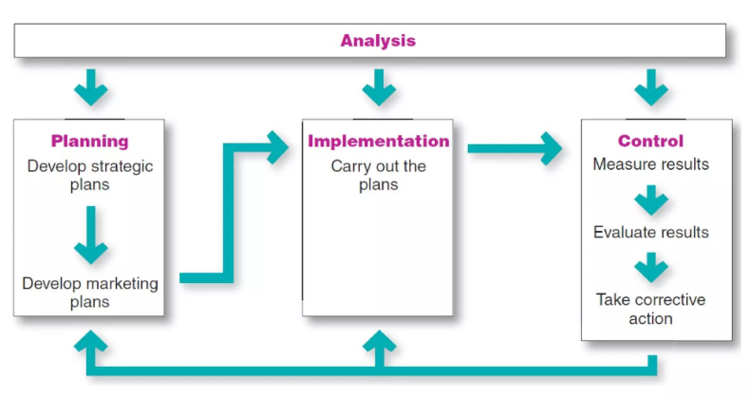
Task of Marketing Management

Slide 14
Marketing Challenges of 21 Centaury
Marketing challenges for the 21st century encompass the obstacles, complexities, and opportunities that organizations face in effectively reaching and engaging with customers in the modern digital age. These challenges are shaped by rapid technological advancements, evolving consumer behaviors, globalization, regulatory changes, and shifting competitive landscapes. Here are some key aspects of marketing challenges in the 21st century. Michael porter has identified five marketing challenges of the firms:
Threats of new entrants in the business
Threats of substitute products that the competitor brings in the business
Increased bargaining power of the buyer
Bargaining power of the supplier
Rivalry among competing firms in industry.

Slide 15
The major challenges of the 21st century can be viewed as follows:
Customer are being more savvy or informative than the marketers.
Customer are increasingly demanding better quality and reliability in the products and services they buy.
Customer wants, needs and expectations are changing more rapidly.
New products and services are coming to markets more quickly than in the past.
Competitors have introduced multiple brands and competition for sales is intense
Medias are being more fragment and expensive.
Global competition
Significant impact of internet in business practices.
Increased accountability of marketers towards customer.

Slide 16
Challenges for a Marketer
In the 21st century, marketers face a unique set of challenges shaped by technological advancements, changing consumer behaviors, and a rapidly evolving business landscape. Here are some key challenges for marketers in the 21st century:
Budget allocation: Media has become fragment and expensive. Media planning and scheduling has become challenge for the marketers.
Differentiation: All firms broadcast advertisement through various channels and customer watch such advertisement and differentiate product and services. Competitor make effort to present their product and service distinct. These days it is very crucial for marketers to differentiate their product and services through advertisement.

Slide 17
Brand Recall: There are numerous number of brand names in the market for competing product and services. They advertise their product for the brand recall. To maintain brand recall in the market, marketers need to use several marketing tactics and spend a huge sum of money in advertisement.
Brand Positioning: Every marketers must try to achieve the right positioning for their brand. Brand positioning has become significant and holistic activity for the marketers to motivate and impress customer through advertisement.

Slide 18
Firms Response to Marketing Challenges
Developing marketing plans that are designed to build long term profitability
Developing cogent argument to protect or increase the investment in marketing.
Developing of framework that creates a good balance between the need of the customer and those of the organization.
Developing effective strategies that engages those outside of marketing that were crucial to deliver the promise to customers.
Developing right metrics to monitor progress and provide accountability.
Motivating others to be passionate about data quality, as fit for purpose data is vital in direct, digital and CRM based marketing.

Slide 19

Thank you

